Slide 1
Welding Auto run X-Y concept
08. Mar. 2026
Hai Phong
DN, HT

Slide 2
Intro
Goal to reduce moving time of X-Y table during welding process.
Improve uph, safety of Petalite production without manual touch and reduction ~20% cycle time comparing with Prototype tact time.
Operation concept:
Concept #1: Use DIO device to get voltage 24V from welding machine and covert to digital logic to control X-Y moving table & welding activity. The coordinate of welding position should be intergrate with G-code for easy exchange welding sequence. Automation tool can integrate with emergency button/light curtain.
This document describle in detail for this concept and intent to make project own by RRC VN.
Advantage: VN team can proactive to make/modify software/hardware in the future
Disadvantage: Need long time to progamming device / limit knowledge about welding device HW/SW communication.
Concept #2: Use currently available signal from SPS poor man tool to get welding signal through internal modbus interface and customization to control auto moving of X-Y table.
Automation tool can integrate with emergency button/light curtain.
Advantage: Have available source code on hand, just customize for our application -> save time to apply for Pre-Series Petalite.
Disadvantage: Source code is made from Markus and it is not convenience to modify.

Slide 3
Concept of Auto run X-Y Welding
BLOCK DIAGRAM
Digital Output:
DO0 – X1.7 program numb 0
DO1 – X1.8 program numb 1
DO2 – X1.9 program numb 2
DO3 – X1.10 program numb 3
DO4 – X1.11 program numb 4
DO5 – X1.3 Reset out of limits
DO6 – X1.15 START
DO7 – X1.30 Enable input
DO_GND – X1.35
Welding Machine Input (DB37 X1)
X1
DIO DEVICE 24V
(ADAM-6052-D)
DO0
DO1
Ethernet (RJ-45)
…
DO2
DO7
DI1
Control DI,DO
Auto run_xy.py
NUC PC (NUC 175.25.103.112)
Welding Machine Output (DB37 X2)
X2
…
Digital Input:
DI0 – Worker “MOVE” Button
DI1 – EMERGENCY Button
DI2 – Light Curtain Emergency
DI3 –
DI4 –
DI5 – X2.20 Out of limit I,U,P
DI6 – X2.5 Out of limit head 1
DI7 – X2.3 FK
DI_COM – X2.36
Control X,Y
X-Y Table (MOC-02)
RS232

Slide 4
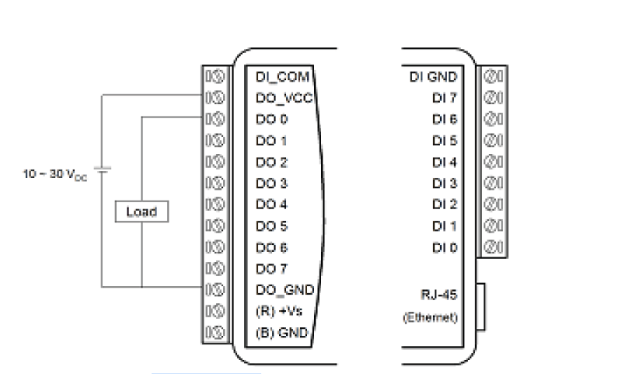
Digital Output:
DO0 – X1.7
DO1 – X1. 8
DO2 – X1.9
DO3 – X1.10
DO4 – X1.11
DO5 – X1.12
DO6 – X1.15 START
DO7 –
DO_GND – X1.35

Slide 5

Concept of Auto run X-Y Welding
FLOW CHART EXECUTION
Start script
*Worker
position
Put battery, cell tab into jig
Scan new label
Take out scrap/completed pack
Move to Worker Position
Auto: Optical inspection, switch, … “MOVE” button -> start moving xytable to next target position
“EMERGENCY button” -> Operator action when detecting sticky electrode issue.
“GRIND” button -> start moving xytable to grinding position
NO
Check “MOVE”
Button?
YES
Check “MOVE”
Button?
NO
YES
NO
YES
YES
Position
i =42?
Check “MOVE”
Button?
Move to position i=i+1
Move to welding
position i = 1
Stop XY
movement
NO
NG
NO
OK
NO
YES
Move to worker position
Flip battery pack
Auto-Welding
Welding result i?
Sticky Check?
Position
i =21?
YES
Electrode Grinding
Move to grinding position
NO
Grinding done?
YES
XY Stop at current position i
Operator press “EMERGENCY” BUTTON
Check “GRIND”
Button?
YES
NO
End

Slide 6
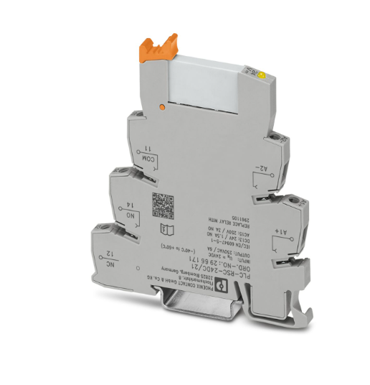
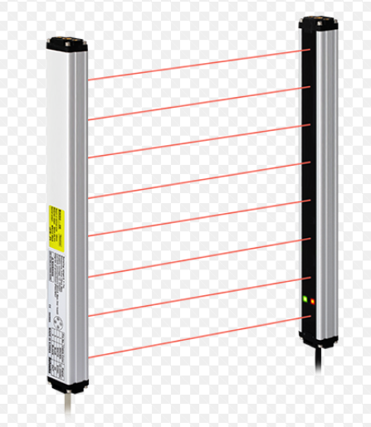
24V
Switch
L
NPN
COM
Receiver
A2
1. Brown
2. White
3. Black
4. Blue
NO
NC
1. Brown
2. White
3. Black
4. Blue
A1
Emitter
XY Table
E.Stop (NC)
COM
A2
NO
E.Stop (NO)
DI_GND (ADAM-6052-D)
A1
DI2
DI1
DI (ADAM-6052-D)
N
0V

Slide 7
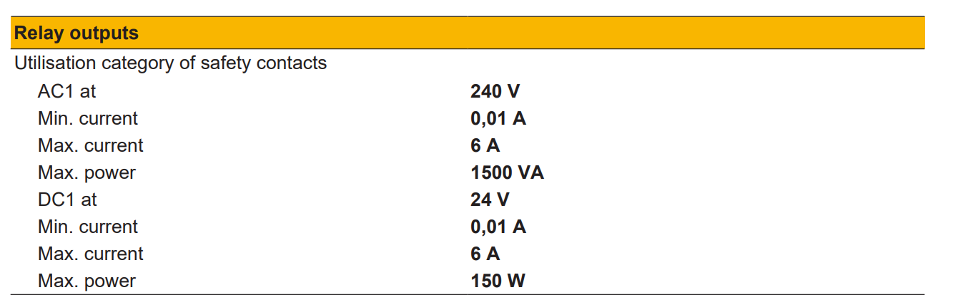
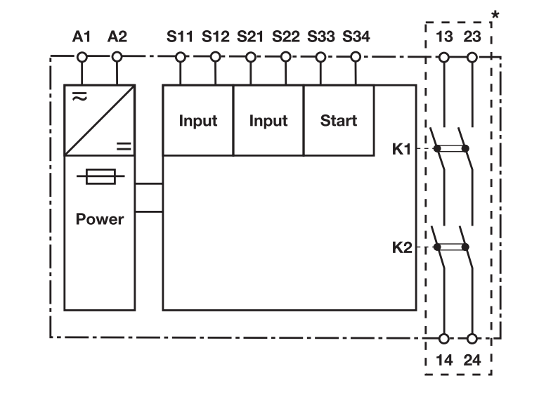
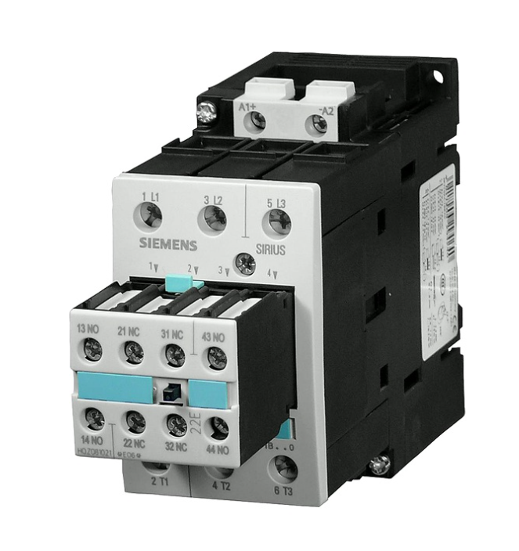
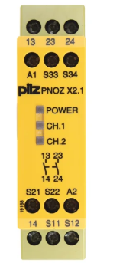
Switch
+24V
0V
L1 (XY Motion)
L1 (Welding M)
L2
L3
E.Stop
Light Curtain
START/RESTART
3RT1036-1BB40 Siemens
PNOZ_X2.1
XY Motion MOC-02
Welding machine ISQ250

Slide 8
Switch
+24V
0V
L1 (XY Motion)
E.Stop
Light Curtain
START/RESTART
DI_GND
Digital Input (ADAM-6052-D)
DI1
PNOZ_X2.1
XY Motion MOC-02

Slide 9
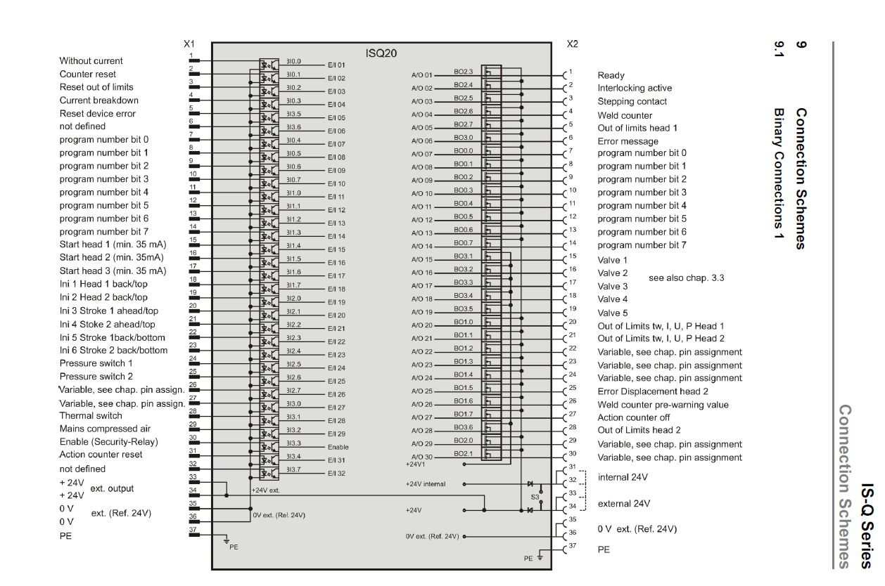
IQS20 X2 Connector DB37 Diagram

Slide 10
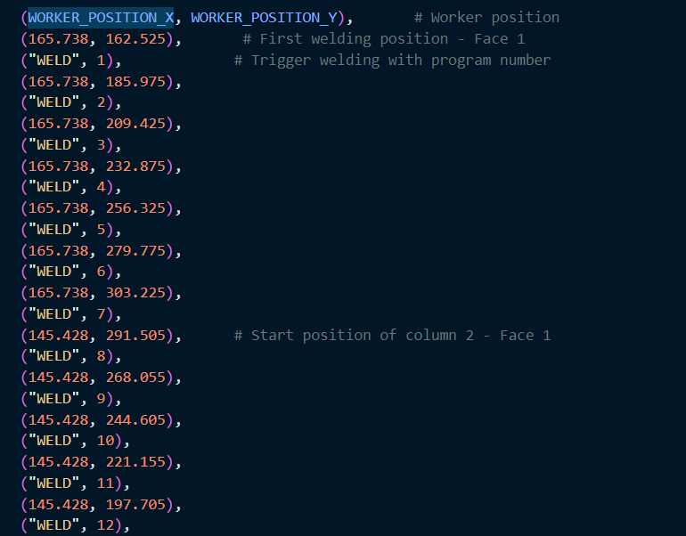
Welding Positions
(WORKER_POSITION_X, WORKER_POSITION_Y) #worker position
("WELD", i) # weld function
i from 1 to 42
Should use G-Code in separate file and trigger codinate from
this file through Python

Slide 11
Set up condition
Prepare device DIO 24V / Power supply / DB37 terminal female, start & emergency button are available 26.Mar.26
Programming by Python with public API library from Optic – Focus and USB DIO device
Can use current library from RRC from SPS poor man tool.

Slide 12
Project plan
Define concept ~ 29.Jan – Team / Done
Hardware is available ~26.Mar
Code Python to control DIO device and get signal from welding machine ~ 15.Apr
Programming the tool to automate welding ~ 17.Apr
Generate Python tool with UI that worker can operate the tool ~ 20.Apr
Test completes and close project – 21.Apr

Slide 13
Appendix. User manual
User manual and Software guidance of MOC-02-1-220:
https://optics-focus.com/motion-controller-for-nema23-and-nema17-stepper-motor-220v-p-974.html
User manual of Welding panel AWS3 System

Slide 14
Thank you for your attention

